Slide 1
Functions
Week 4
https://www.tutorialspoint.com/execute_python_online.php
You can use this compiler

Slide 2
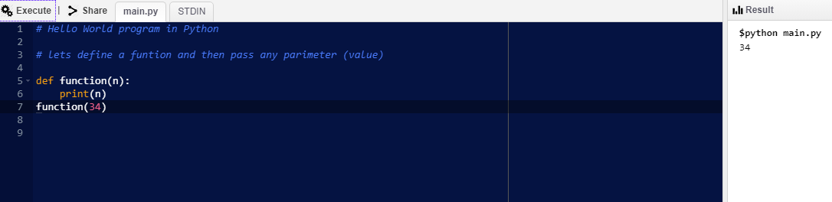
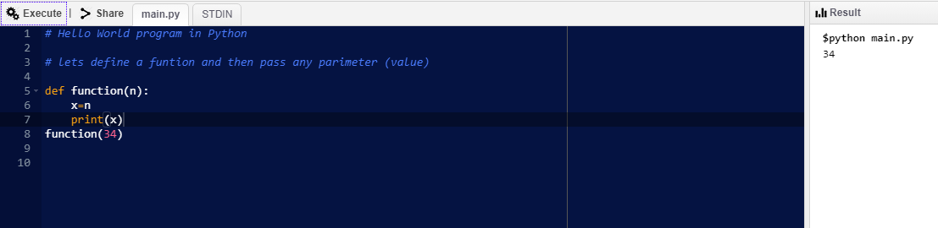
Functions in Python serve the purpose of both functions and subroutines in other languages.

Slide 3
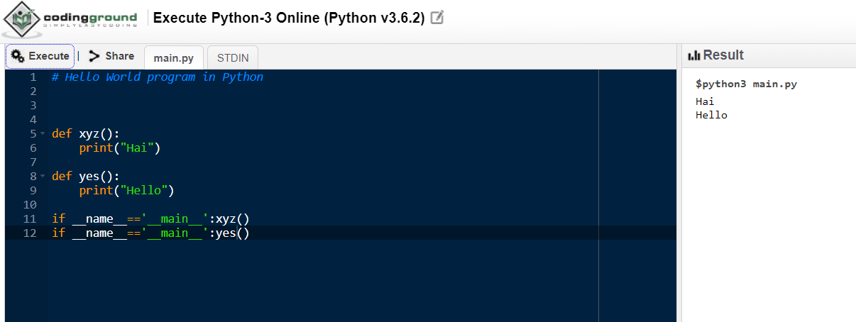

Slide 4
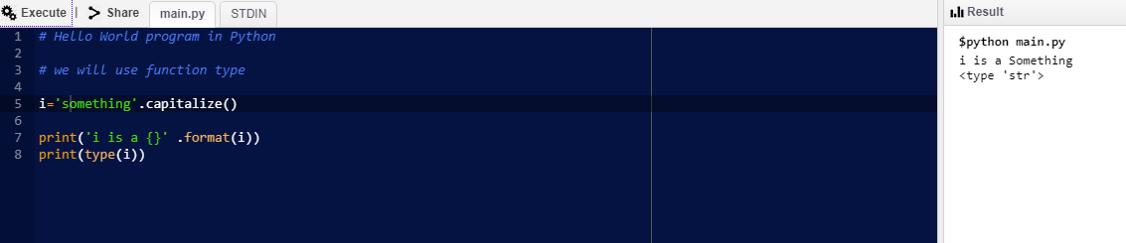
Lets look at strings
In Python, the capitalize() method returns a copy of the original string and converts the first character of the string to a capital (uppercase) letter while making all other characters in the string lowercase letters

Slide 5
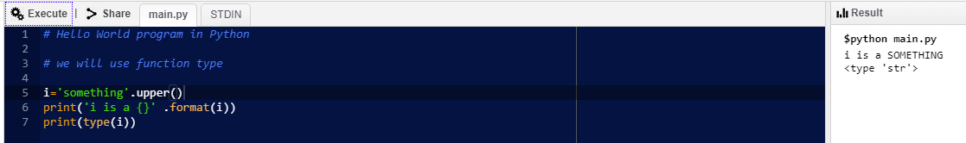
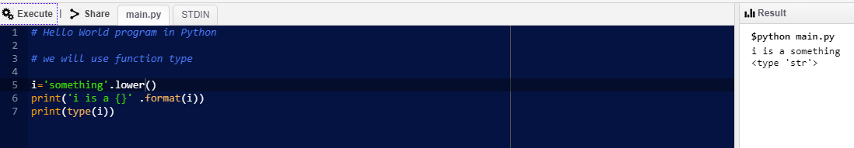
Upper function /lower

Slide 6
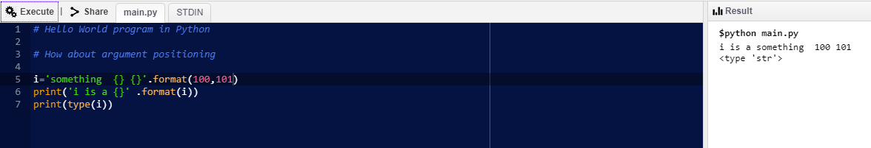
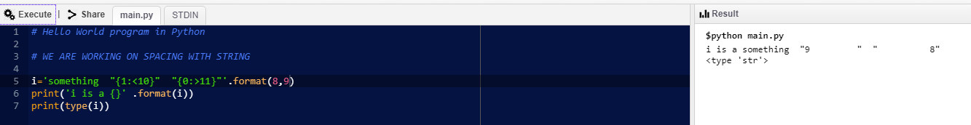
How about argument positioning

Slide 7
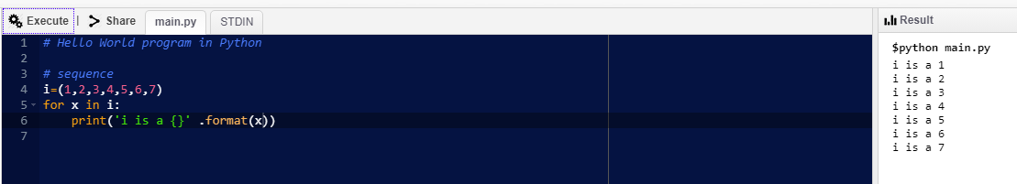
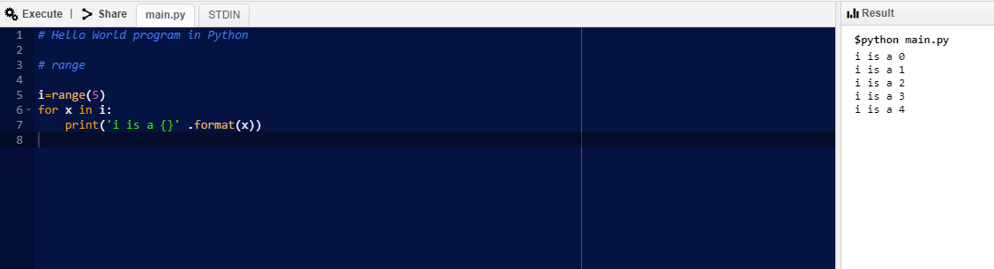
for loop for a sequence
for loops are used when you have a block of code which you want to repeat a fixed number of times. The for-loop is always used in combination with an iterable object, like a list or a range. The Python for statement iterates over the members of a sequence in order, executing the block each time

